Slide 1
Getting Started
Chapter 1

Slide 2
What are the behaviors and attitudes of an “A” student?
List three important behaviors that an “A” student would have.
Get in a group of three students and compare lists.
Report.

Slide 3

What Do I Want from College?

Slide 4
Exercise:
What Do I Want from
College?
Share your most important reasons with the class.

Slide 5
Value of a College Education

Slide 6

Education Increases Earnings

Slide 7

Yearly Income
HIGH SCHOOL $33,904
SOME COLLEGE $37,804
ASSOCIATE $40,820
BACHELORS $55,432
MASTERS $67,600
PROFESSIONAL $90,220

Slide 8
Lifetime Income
HIGH SCHOOL $1,017,120
SOME COLLEGE $1,134,120
ASSOCIATE $1,224,600
BACHELORS $1,662,960
MASTERS $2,028,000
PROFESSIONAL $2,706,600

Slide 9
What is the Value of a College Degree?
$1,662,960 College Graduate
$1,017,120 High School Graduate
$645,840 Value of College
Degree

Slide 10

How much is each college class worth?

Slide 11
$16,146 per 3 unit class
($645,840 divided by 40 classes for a BA or BS)

Slide 12

What is one hour of a college class worth?

Slide 13
$336 per hour in class ($16,146 divided by 48 hours in class)

Slide 14

Would you attend class today and be prepared if I paid you $336?

Slide 15
Of course, these payments are over a working lifetime of 30 years.

Slide 16
Choosing Your Major
Making a good choice of a major helps increase your motivation for success.

Slide 17
How to Choose a Major
What is my personality type? What are my personal strengths?
What are my multiple intelligences?
What are my interests?
What are my values?
How can I match my personal strengths to the world of work?

Slide 18
How do you motivate yourself?
What if you don’t feel like coming to class or doing your homework. How do you motivate yourself to do it anyway?
      Think
      Discuss with the person next to you
      Share ideas

Slide 19
There are many ways to be motivated. Let’s see if any are useful to you.
Think positively about the future
Look for something interesting
Improve your concentration
  Manage your external environment
Intrinsic or extrinsic motivation
Locus of control
Achievement motivation
Use a reward

Slide 20


Slide 21
No pessimist ever discovered the secrets of the stars, or sailed to an uncharted land, or opened a new doorway for the human spirit.
Helen Keller

Slide 22
Benefits of Positive Thinking
Good health
Longevity
Happiness
Perseverance
Improved problem solving
Enhances ability to learn

Slide 23
If you are optimistic and believe that a goal is achievable, you are more likely to take the steps necessary to accomplish it.

Slide 24
Optimism Vs. Pessimism
How does it apply to college?

Slide 25
Find something interesting in your studies.
Exercise: Textbook Skimming

Slide 26

Ways to Improve Your Concentration

Slide 27
Concentration and motivation are connected.
If you can focus on what you are doing, you are motivated to continue.

Slide 28
Minimize Distractions
If you study in the kitchen, you will be distracted by food
If you study in front of the TV, you will be tempted to watch it
If you study in bed, it will be difficult to say awake

Slide 29
Be Here Now
Choose where you will place your attention
When your mind wanders, gently bring it back. Forcing attention does not work.

Slide 30
For example, do not think about pink elephants!

Slide 31
How many of you thought about pink elephants?

Slide 32
When your mind wanders, gently bring it back to the here and now.

Slide 33
Can you be here now for two minutes?

Slide 34
Focus on this number for 2 minutes:
1

Slide 35
Where did your mind go during these two minutes?

Slide 36
The Spider Technique
Learn to ignore distractions and keep your attention focused

Slide 37
Set up a Worry Time
Set a time each day
When worries distract you, remind yourself of the time set aside to worry
Be here now
Keep your worry appointment
Find solutions

Slide 38
Increase Your Activity
Take a break
Stretch
Move
Read and listen actively

Slide 39
The Checkmark Technique
When you find yourself distracted, place a checkmark on a piece of paper and refocus your attention
With practice you will have fewer checkmarks and distractions

Slide 40
Change Topics
You may need to study for a short period of time and change subjects.

Slide 41

Motivation is a key to success.
How can you motivate yourself to be successful?

Slide 42
Intrinsic Vs. Extrinsic Motivation

Slide 43
Motivation
Intrinsic motivation comes from within.
  Look for ways to enjoy college and find some personal meaning in it.

Slide 44

Motivation
Extrinsic motivation comes as a result of an external reward.
What is the payoff for attending college?
Higher earnings
Having a satisfying career
Buying a car or home

Slide 45
Which is the more powerful motivator?
Intrinsic or extrinsic motivation?

Slide 46
Intrinsic motivation is the most powerful.

Slide 47
Taking Control of Your Life
Where do you place the responsibility for control over your life?

Slide 48


Slide 49
Locus of Control
Where you place responsibility for control over your life
  Internal
  External

Slide 50
Locus of Control
Internal
External
Believe you are in control of your life.
Be self-motivated.
Learn from mistakes.
Think positively.
Rely on yourself.
Life is a result of luck or fate.
Rely on others for motivation.
Look for someone to blame.
Think negatively.
Rely on others.

Slide 51
What is more likely to lead to achievement in college?
Internal Locus of Control?
External Locus of Control?

Slide 52
Internal locus of control is most likely to lead to success in college.

Slide 53
Exercise: Locus of Control
CSI Activity

Slide 54
More Types of Motivation

Slide 55
Affiliation Motivation

Slide 56
How can you use affiliation motivation to be successful in college?

Slide 57
Affiliation Motivation
Study Groups
Friends
Athletics
Clubs
Activities

Slide 58
Achievement Motivation

Slide 59
Are you motivated by achievement?
Competition for grades
Winning the game
Earning money
Recognition for achievement

Slide 60
Learning and Motivation
Psychologists believe that much of our behavior is learned.

Slide 61

Find a reward to increase desirable behavior.

Slide 62

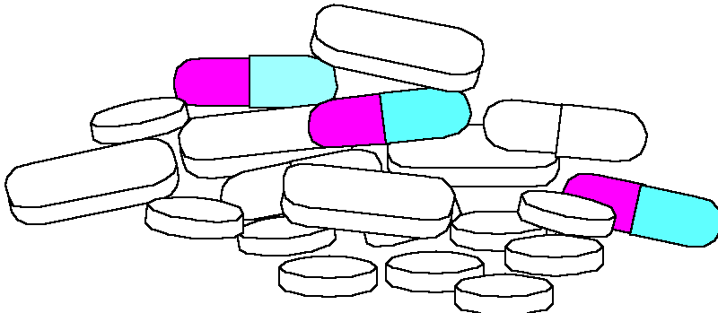
Good rewards:
1. Do not involve alcohol or drugs

Slide 63



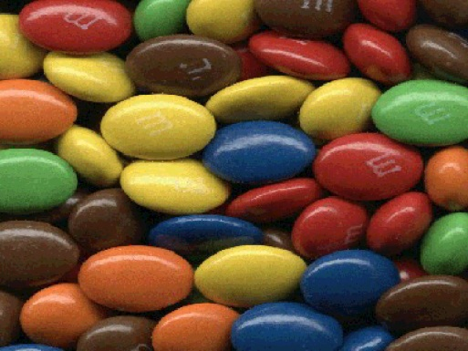
Good rewards:
1. Do not involve alcohol or drugs
2. Do not have too many calories

Slide 64

Good rewards:
1. Do not involve alcohol or drugs
2. Do not have too many calories
3. Do not cost too much money

Slide 65

What are some good rewards for studying?

Slide 66
How does health affect learning?

Slide 67
Get Started, Get Healthy
Get enough sleep
Get some exercise
Eat healthy
Learn to relax

Slide 68

Lack of Sleep Causes
Difficulties with memory and learning
It decreases your IQ by 25 points
Increased irritability
Accidents
Illness
Lack of energy
Stress
Rapid aging
Weight gain

Slide 69
Staying up late and cramming for a test is probably not a good idea!

Slide 70
Be Physically Active Each Day

Slide 71
Adults Need 30-60 Minutes of Moderate Activity Each Day
Moderate activity is one that requires as much energy as walking 2 miles in 30 minutes.

Slide 72
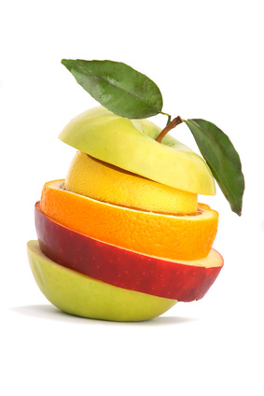
Nutrition: You Are What You Eat

Slide 73
Aim for a Healthy Weight

Slide 74
What is the best way to maintain a healthy weight?

Slide 75

Maintain a healthy weight through:
Healthy eating
Exercise

Slide 76
Calculate Your Body Mass Index (BMI)
A common method of evaluating your weight
BMI= 705 X Body Weight Divided By (Height X Height)

Slide 77
BMI
Less than 18.5
18.5-24.9
25-29.9
30 and above
Under weight
Normal weight
Overweight
Obese

Slide 78
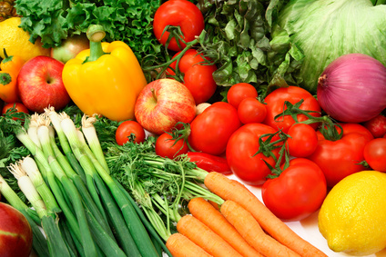
Nutrition Test

Slide 79
What would you feed a 6 year old for breakfast before you send him or her to school?
Write your answer on a separate
sheet of paper.

Slide 80
Let’s hear some examples.

Slide 81
Nutrition Test, Part II
What did you have for breakfast
this morning? Write this on a sheet
of paper.

Slide 82
Nutrition Test: Part III
How many teaspoons of sugar are in a can of soda?

Slide 83
There are 9 teaspoons of sugar in a can of soda!

Slide 84
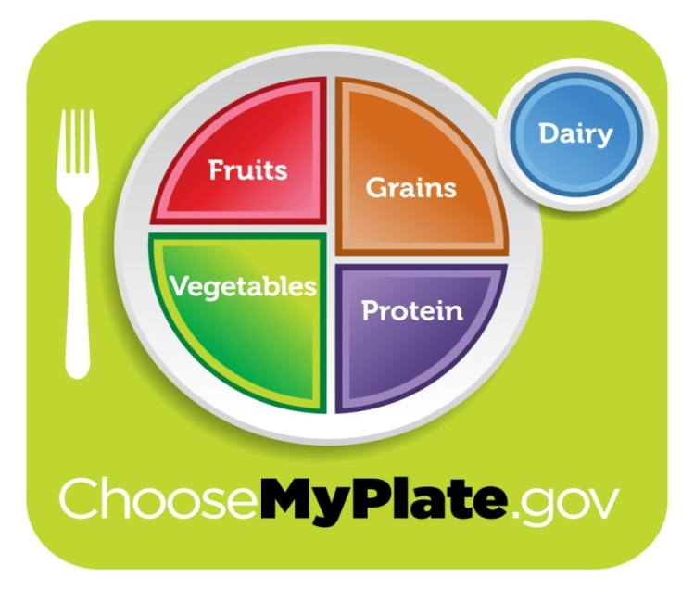
Use Choose My Plate to
Guide Your Choices
About 2/3 of the plate is filled with vegetables, fruits and grains.

Slide 85
Learn to Relax

Slide 86
Make exercise such as a brisk walk for 30 minutes, a part of your daily routine. Exercise uses up the stress hormones.

Slide 87

Music
Use a beat slower than your heart rate.

Slide 88
Stress Management Checklist
Manage your time and organize your things
Don’t spread yourself too thin
Learn to say “no”
Cultivate friends
Participate in an extracurricular activity
Do something fun every day

Slide 89
Stress Management Checklist
Exercise regularly.
Eat sensibly.
Get enough sleep.
Learn to relax.

Slide 90
Take Action to Reduce Stress
Concentrate your efforts on doing something about the problem.
Seek information on how to solve your problem.
Make a plan of action.
Make it a priority to solve the problem.
Do what needs to be done, one step at a time.

Slide 91
Success is a HABIT

Slide 92
Success is a Habit
We establish habits by taking small actions each day.
You can establish habits for success.

Slide 93
Exercise:
I am successful when I:

Slide 94
Exercise:
I am successful when I:
Behaviors which interfere with my success.:

Slide 95
Exercise:
I am successful when I:
Behaviors which interfere with my success:
I would like to:

Slide 96
A PRACTICAL EXAMPLE

Slide 97
Step 1.
State the problem.
I have a chocolate chip
cookie eating habit.

Slide 99
Step 2
Choose one small behavior at a time
Make it small.

Slide 100

Changing one small behavior is like making a ripple on a lake.

Slide 101
Change one small behavior and you can change your life.

Slide 102
I will eat a healthy snack.
NOT
I will lose weight. or
I will never eat cookies.

Slide 103
Step 3:
State in a positive way the behavior you wish to accomplish.

Slide 104
EXAMPLE
I will eat a healthy snack. instead of eating cookies.

Slide 105
Write an intention statement.
I intend to eat a healthy
snack.

Slide 106
Step 4
Count the behavior
How many cookies do I
eat each day?

Slide 108
Step 5:
Picture in your mind the actions you will take. Visualize your success.

Slide 109
Step 6
Practice
10 days
Keep a Log

Slide 110
Step 7
Find a reward for your behavior.

Slide 111
Step 6: What reward will you use?

Slide 112
10 Habits of Successful College Students
Attend class.
Read the textbook.
Have an educational plan.
Use college services.
Get to know the faculty.

Slide 113
10 Habits of Successful College Students
Limit outside employment to 20 hours a week for a full time student.
Take one step at a time.
Have a goal for the future.
Visualize your success.
Ask questions.

Slide 114
Assignment
How to Change a Habit
Keep a log for 10 days

Slide 115
Keys to Success: Persistence

Slide 116
Persistence Will Get You Almost Anything Eventually
When is this true?
When is it not true?

Slide 117
90% of success is showing up!
(You also have to do some work when you get there.)

Slide 118
Make a commitment to reach your dreams.

Slide 119
Getting a college degree can be like climbing Mt. Everest.

Slide 120
How to Climb Mt. Everest
A small step at a time

Slide 121
Succeed in college one step at a time.
Get started.
Attend the first class.
Read the first chapter.
Start a new study habit.

Slide 122

Assignment
Measure Your Success

